Slide 1

Exploratory Data Analysis
G2M Analysis for Cab Company Investment
Presented by: Jesumbo Oludipe
21/03/2023

Slide 2

Agenda
Executive Summary
Problem Statement
Approach
EDA
Recommendations

Slide 3
Executive Summary
XYZ, a private firm in the US, is planning to invest in the cab industry and wants to understand the market before making an investment decision.
To help them identify the right company for investment, data sets containing information on two cab companies have been provided.
The goal is to generate actionable insights to make an informed investment decision.

Slide 4
Problem Statement
The project involves investigating multiple hypotheses related to the cab industry, including
seasonality in the number of customers using cab services,
identifying the company with the highest profit margins and maximum number of cab users at a particular time,
and understanding the attributes of customer segments.

Slide 5
Approach
The data sets provided include Cab_Data.csv, Customer_ID.csv, Transaction_ID.csv, and City.csv.
The analysis involves reviewing the source documentation, understanding field names and data types, identifying relationships across the files, and creating a master data set.
The investigation also involves identifying and removing duplicates, generating Key Performance Indicators (KPIs) and metrics, and creating visuals to show the results of the analysis.

Slide 6
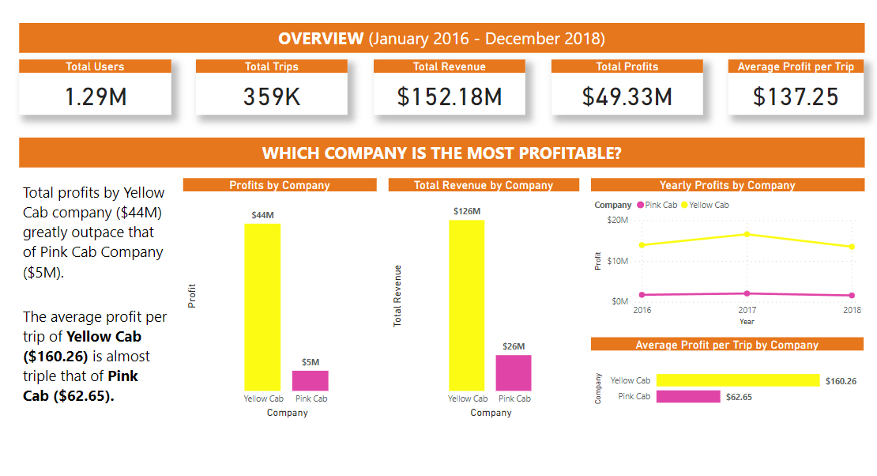
Exploratory Data Analysis (EDA)

Slide 7
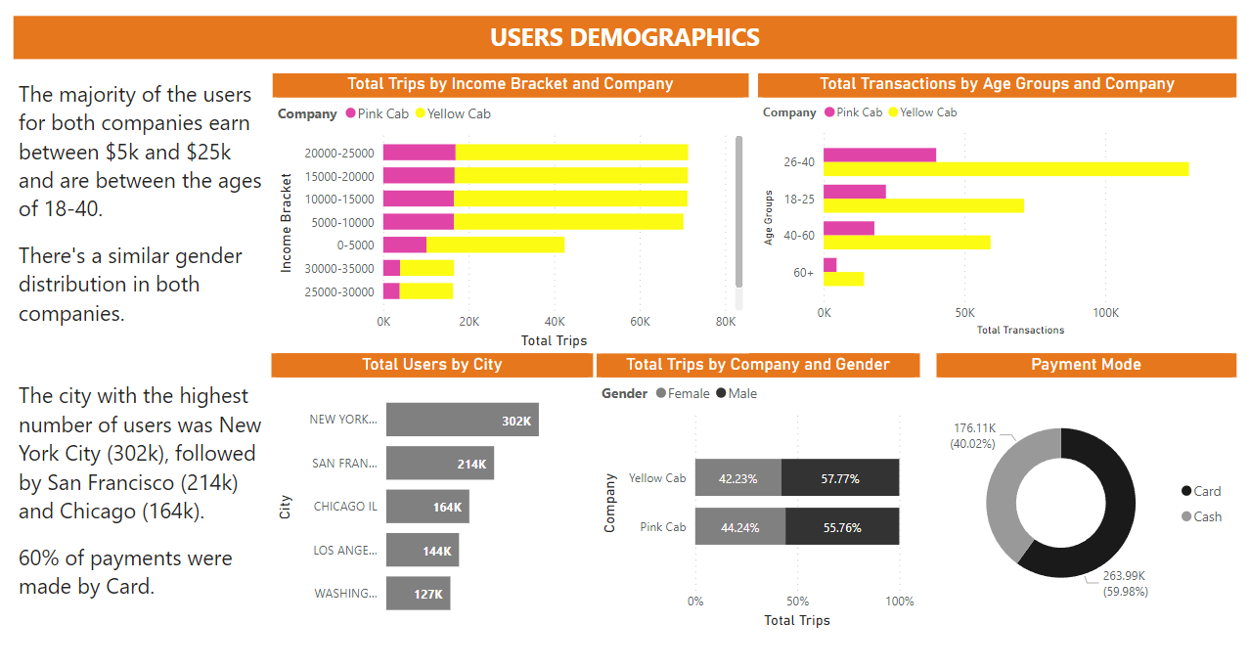
Exploratory Data Analysis (EDA)

Slide 8
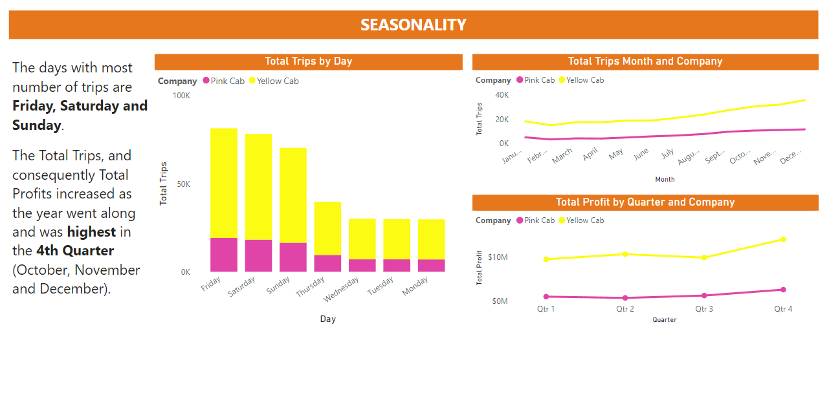
Exploratory Data Analysis (EDA)

Slide 9
Recommendations
Based on the EDA, we recommend investing in the Yellow Cab Company, which has a larger market share and a higher number of customers. Yellow Cab Company is the most profitable, generates the highest revenue, and also generates almost triple the average profit per trip of Pink Cab Company.
The analysis also revealed seasonality in the number of customers using cab services, with a peak in months towards the end of the year. Additionally, the analysis identified customer segments with unique attributes, such as business travelers and weekend riders. More cabs should be made available on weekends to ensure maximum service delivery and profits.

Slide 10
Recommendations
The company should increase its presence in the top 5 cities (New York, San Francisco, Chicago, Los Angeles, and Washington) with the highest number of users.
Marketing campaigns should be targeted toward middle-income class people between the age of 16-40 as they represent the group with the highest number of cab users.
Overall, the analysis provides valuable insights into the cab industry and indicates Yellow Cab Company as a viable investment.

Slide 11
Thank You

